Slide 1
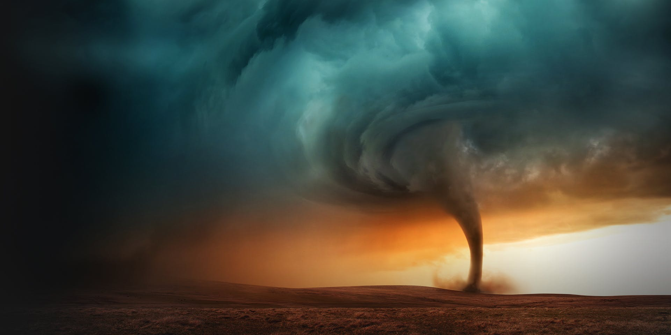
HACKATHON 2k18
Project name: Building Resilience

Slide 2
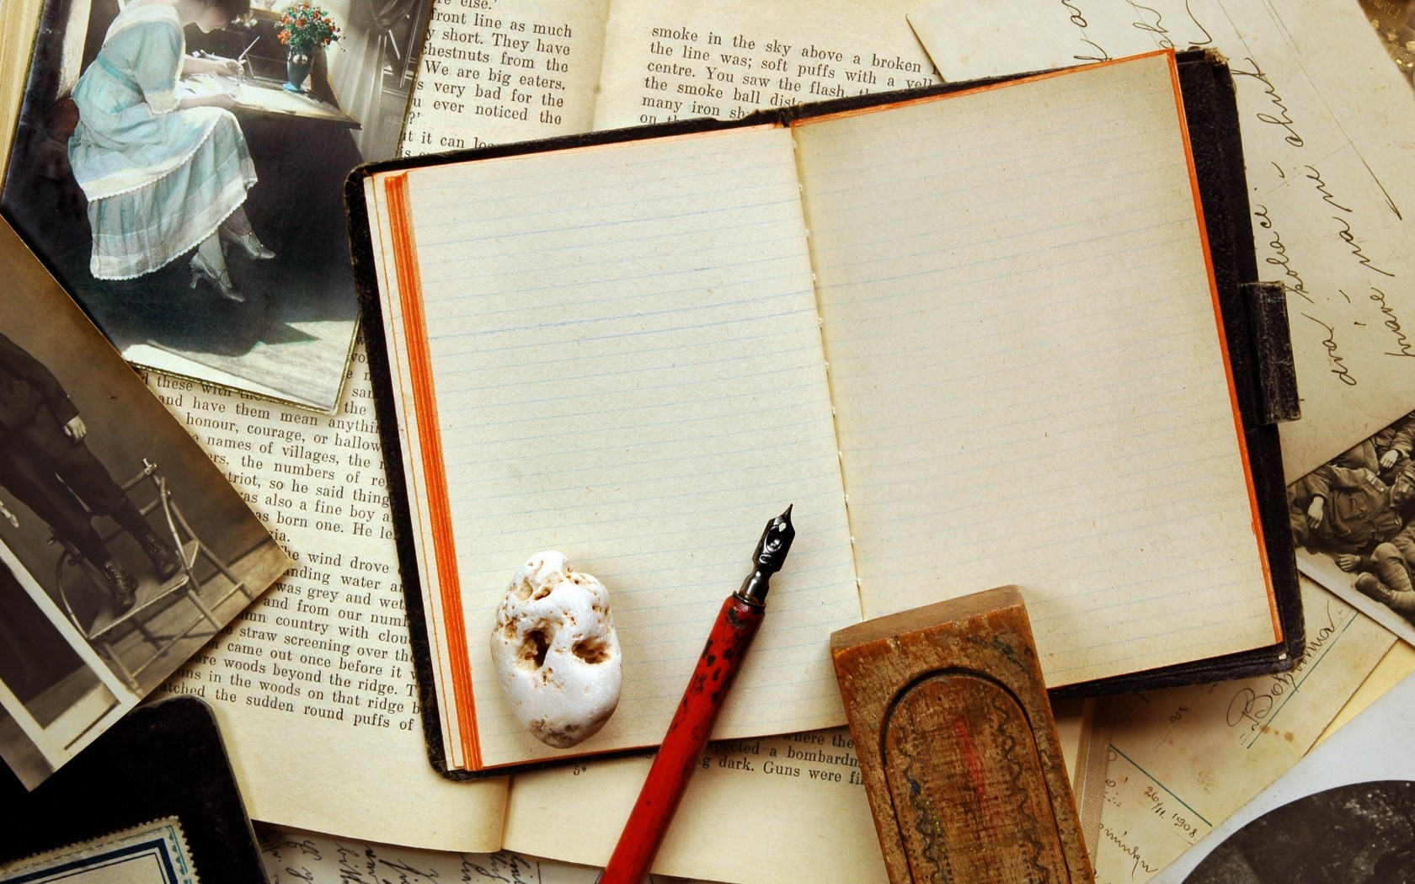
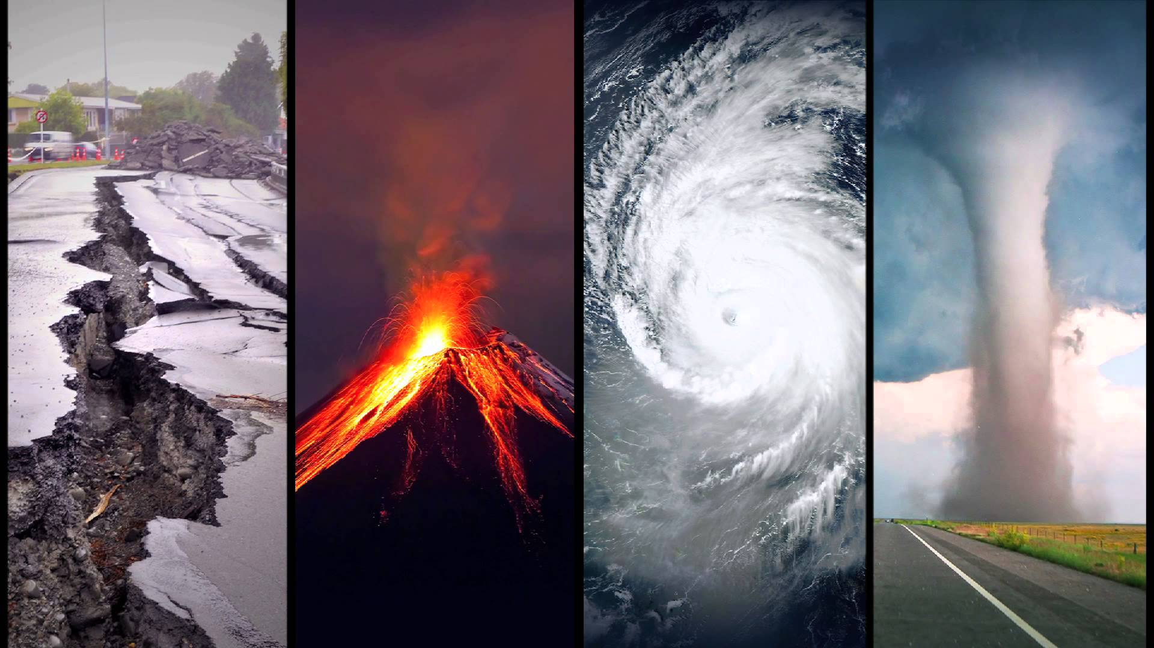
THE
PROBLEM
SAFETY AND WELFARE: Natural Disaster

Slide 3

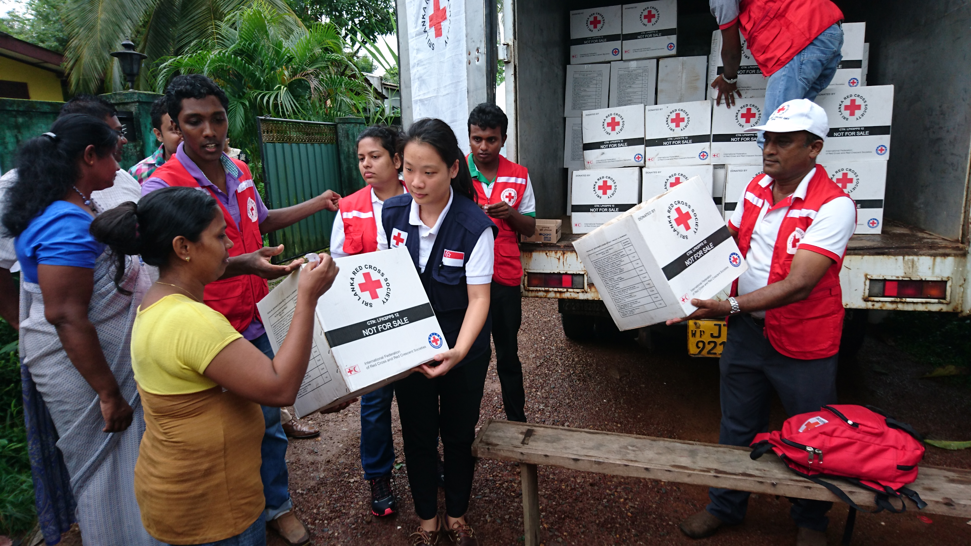
THE IDEA
Helping victims of natural disasters
By connecting them with NGOs.
Providing them aid on time.
Helping them out as quick as possible.
Gathering victim’s experiences.
Connecting a larger number of people all across the country.

Slide 4

THE IDEA: ROADBLOCKS
PROBLEM: At the time of any disaster internet signals often tend to get weak or many a times internet stops working. People are not able to seek help and share their problems due to lack of connectivity.
SOLUTION: It should be ensured that there be at least one place in every city where the internet connectivity is okay. Adding to it, even if some people aren’t able to reach out during the times of disaster when the internet is off, they can still reach out after the disaster during the recovery period when the internet is back.

Slide 5

EXECUTION
Java
HTML
CSS
PHP
Bootstrap
Google forms

Slide 6

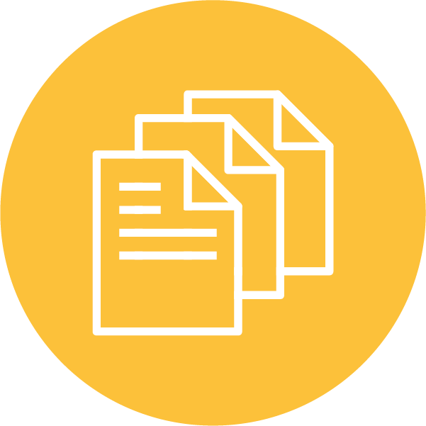
OUR APPROACH
Added forms for blood donation.
Added forms for people to submit their details along with location so that they can be helped.
Provided helpline contact number and website of NGOs of various states.

Slide 7
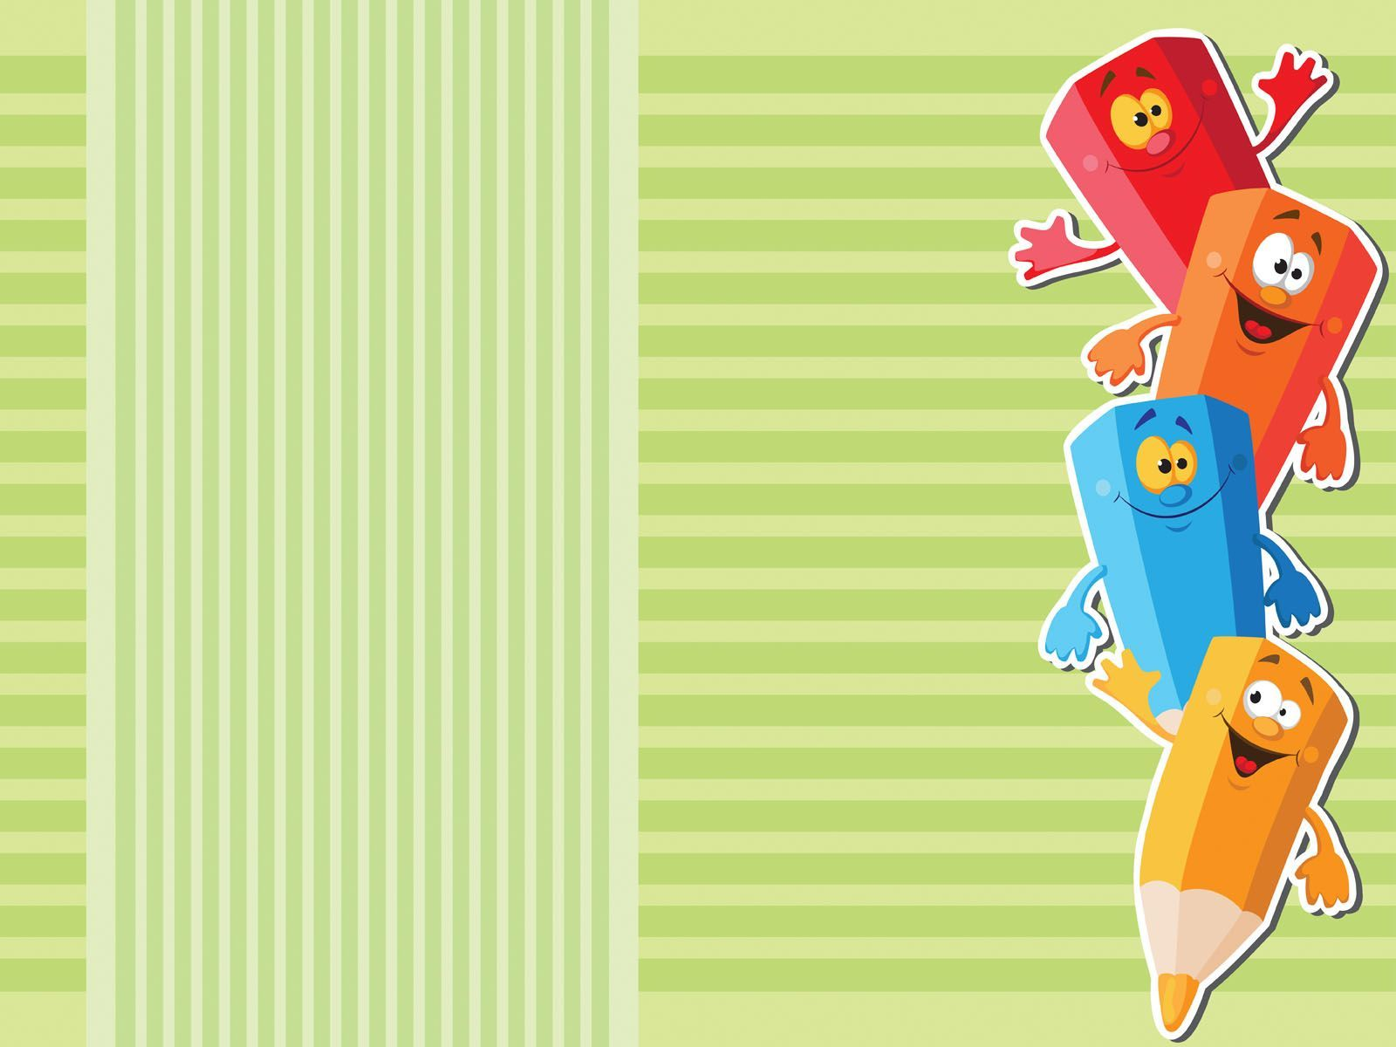
A PROJECT BY
Khushal Agarwal
Amisha Gupta
Kartik Soni
Shreya Jaggi

